Slide 1
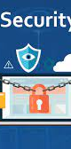

Digital Security

Slide 2
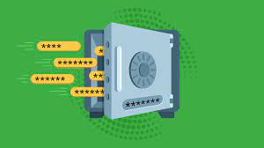
Creating secure password

Slide 3
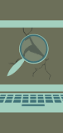
Protection from malware & hackers

Slide 4
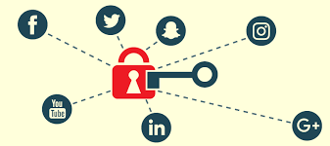
Protect data
on social media

Slide 5
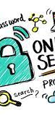
Protect your Personal Information

Slide 6

Protect
sensitive files

